Slide 1
Final Project Presentation
GRP 7: Jonathon Krienbrink, Prannoy Namala, Esther Ojokojo

Slide 2
The Problem
Path Planning for a range of land based robots
Path from a start position (left-bottom corner) to the goal position (4 cells in the center of the maze) needs to be generated in a 16x16 maze.
The walls in the maze are hidden initially and the path needs to be regenerated if there is a wall in the generated path

Slide 3
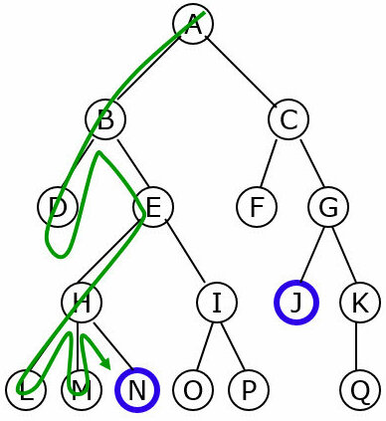
DFS
Starts at root node
Reaches maximum depth in each branch
Backtracking

Slide 4
API Class
Interacts with the MMS simulator.
Provides with helpful methods for robot actions in the simulator.
This project mainly uses:
Wall functions
Movement functions
User interface functions

Slide 5
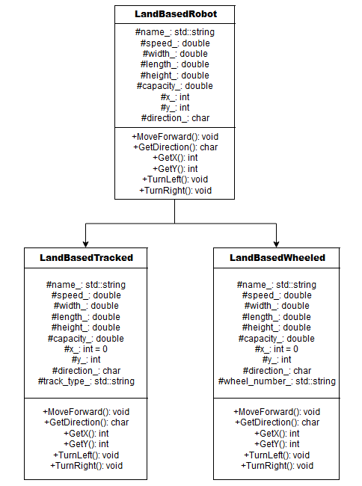
Robot Class
Abstract Class:
LandBasedRobot
Concrete Classes:
LandBasedTracked
LandBasedWheeled
Methods for motion and getters for robot position and direction have been created

Slide 6
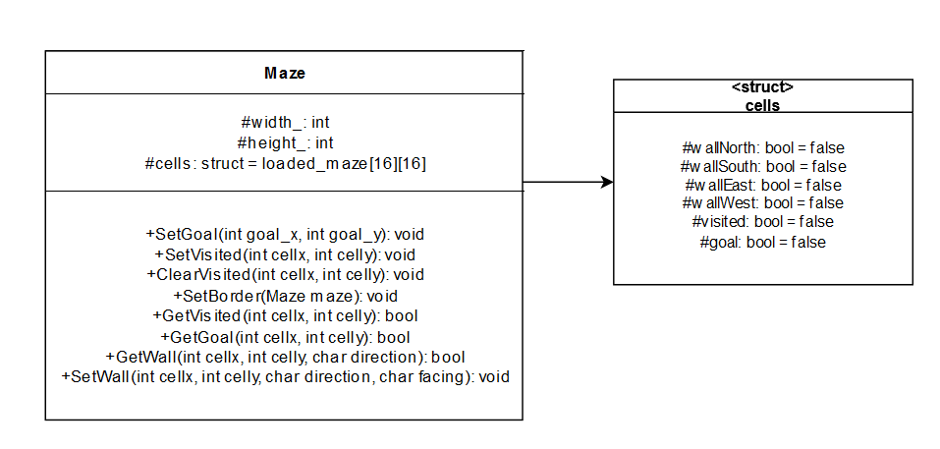
Maze Class
16X16 data struct
Data in each struct:
wall position
has the cell been visited before
is the cell one of the preset goal cells?
Appropriate getters and setters have been created
Notes:
16 x 16 data struct

Slide 7
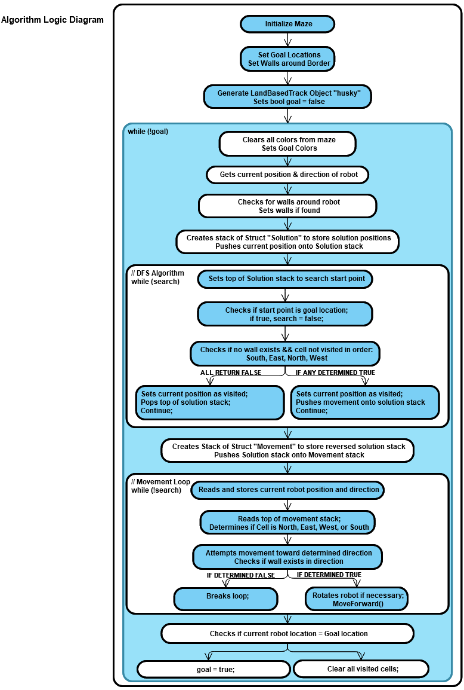
Algorithm Class
Initializing the maze and setting goal position

Slide 8
Algorithm Class
DFS Implementation

Slide 9
Algorithm Class
Moving the robot and checking for completion of the objective

Slide 10

Demo Video

Slide 11
Challenges
Stack smashing
Run Output message : stack smashing detected : <unknown> terminated
Difficulties which were overcome during the course of the project:
Robot not able to move forward in the simulator
Issue with reading walls of a cell
Issue with setting the stack of visited cells
Debugging based on an external UI
Orienting which attributes and methods should belong to each class and properly setting them up to access available attributes.

Slide 12
Future Improvements
Implementation of better algorithm (eg: A* search algorithm)
Using adjacency lists alongside better algorithms
An adjacency list is a collection of unordered lists in which each element contains the locations of neighbouring cells for one cell of the maze

Slide 13
THANK YOU

